Slide 1
Ingress Overview

Slide 2
Services Recap:
In Kubernetes, a Service is a method for exposing a network application that is running as one or more Pods in your cluster.
It is of three main types:
ClusterIP
NodePort
LoadBalancer

Slide 3
Type 1: ClusterIP
Default service type in Kubernetes.
ClusterIP Services are meant for Pod-to-Pod communication only. They aren't accessible from outside the cluster.

Slide 4
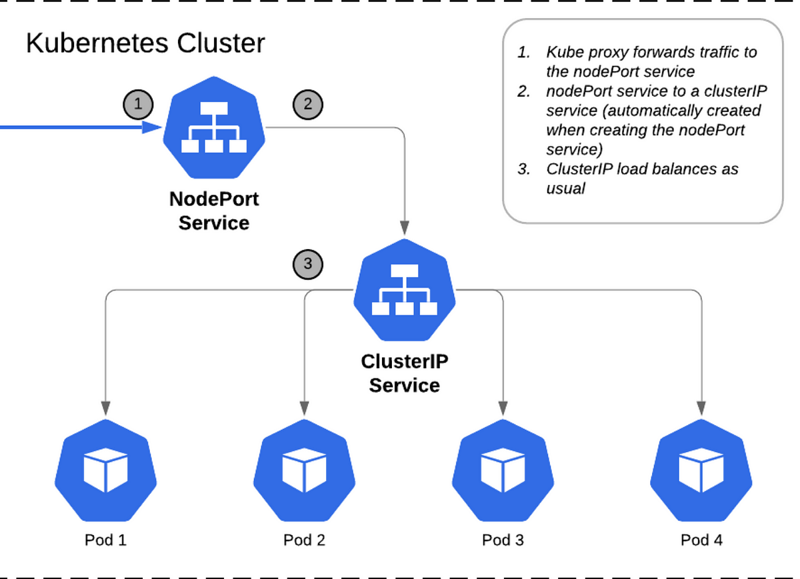

Slide 5
Type 2: NodePort
It is useful when you need to expose your application to external clients. It builds on top of the ClusterIP service.
When you create a NodePort Service, Kubernetes opens a port (in the range of 30000 and 32767) on all of its worker nodes.
All traffic incoming to the worker node's IP address, and that specific port, is redirected to a Pod linked with that Service.

Slide 6
Type 3: LoadBalancer
It is based on the NodePort service and distributes network traffic across multiple instances of an application running in a K8S cluster.
It adds the ability to configure external load balancers in public and private clouds. It exposes services running within the cluster by forwarding network traffic to cluster nodes.
Load balancers in K8S can be implemented by using a cloud provider-specific load balancer such as Azure Load Balancer, AWS Network Load Balancer (NLB), or Elastic Load Balancer (ELB) that operates at the Network Layer 4 of the OSI model.

Slide 7
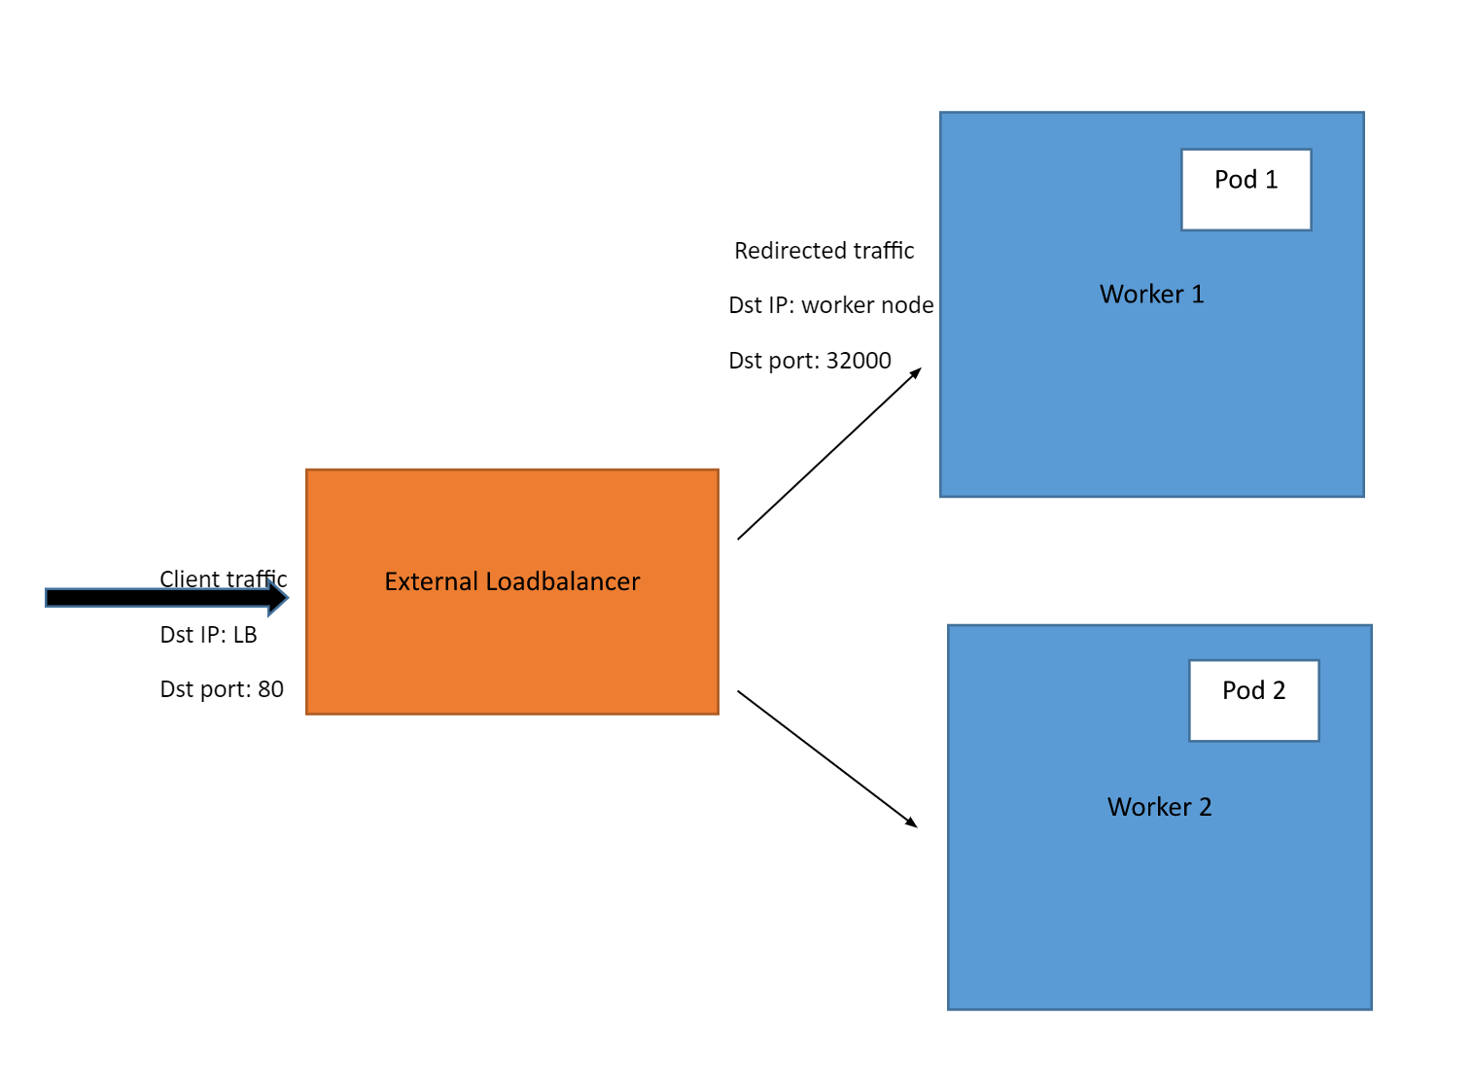

Slide 8
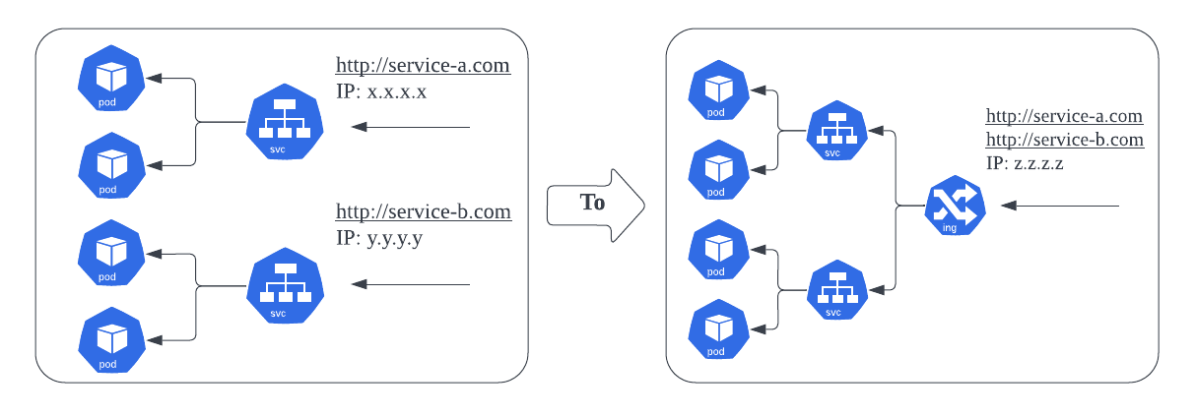
What if there are multiple applications running?

Slide 9
Ingress:
In Kubernetes, an ingress lets us route traffic from outside the cluster to one or more services inside the cluster.
Typically, the ingress works as a single point of entry for all incoming traffic. Then, using a set of rules, it forwards all of its traffic to an appropriate service. In turn, that service will send the request to a pod that can actually handle the request.
Kubernetes Ingress Resource: Kubernetes ingress resource is responsible for storing routing rules in the cluster.
Kubernetes Ingress Controller: Kubernetes ingress controllers (Nginx/HAProxy etc.) are responsible for routing by accessing the DNS rules applied through ingress resources.

Slide 10
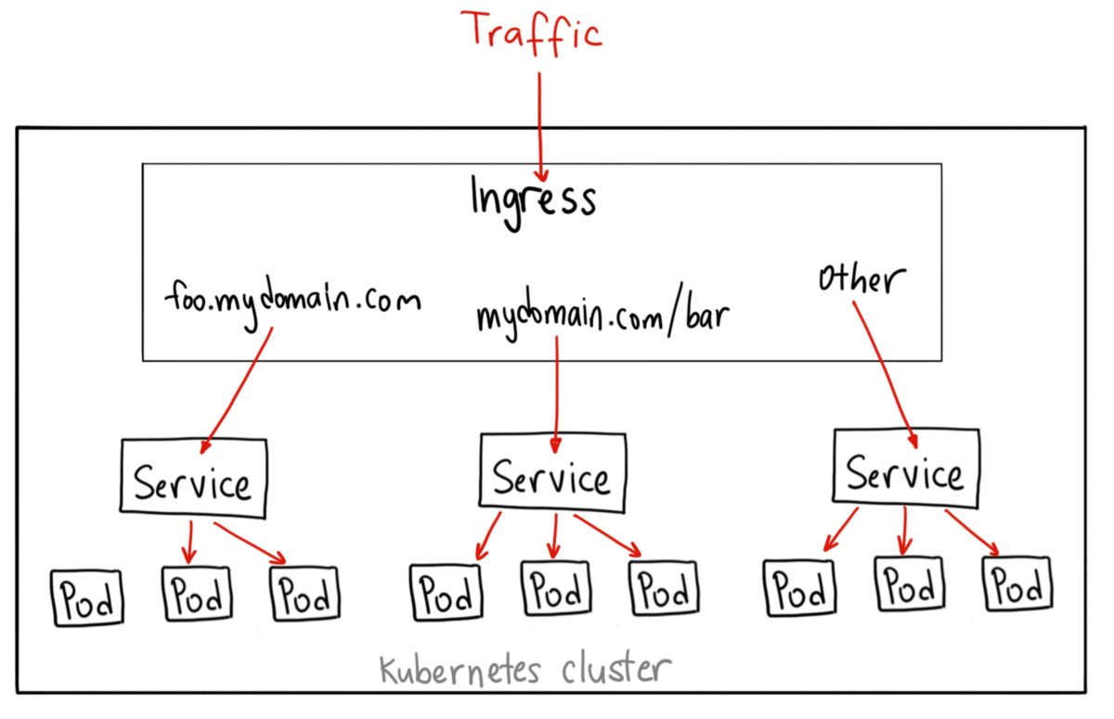

Slide 11
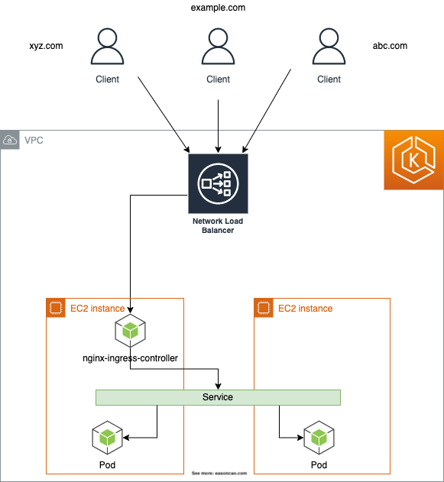
Ingress Controller:
Ingress controller is not a native Kubernetes implementation.
We need to set up an ingress controller for the ingress rules to work. There are several open-source and enterprise ingress controllers available.
Nginx is one of the widely used ingress controllers.

Slide 12
NGINX Ingress Controller
To use the NGINX Ingress Controller in a Kubernetes cluster, you need to deploy the NGINX Ingress Controller as a deployment in your cluster. You also need to create Ingress resources in your cluster to define the rules for routing traffic to the services.
The NGINX Ingress Controller runs as a pod within a Kubernetes cluster. It watches for changes to the Ingress resources in the cluster and updates its configuration accordingly. The Nginx controller talks to Kubernetes ingress API to check if there is any rule created for traffic routing.
When a client sends a request to the NGINX Ingress Controller, it looks up the Ingress rules configured in the cluster to determine which service to route the request to. The NGINX Ingress Controller then forwards the request to the appropriate service and returns the response to the client.

Slide 13
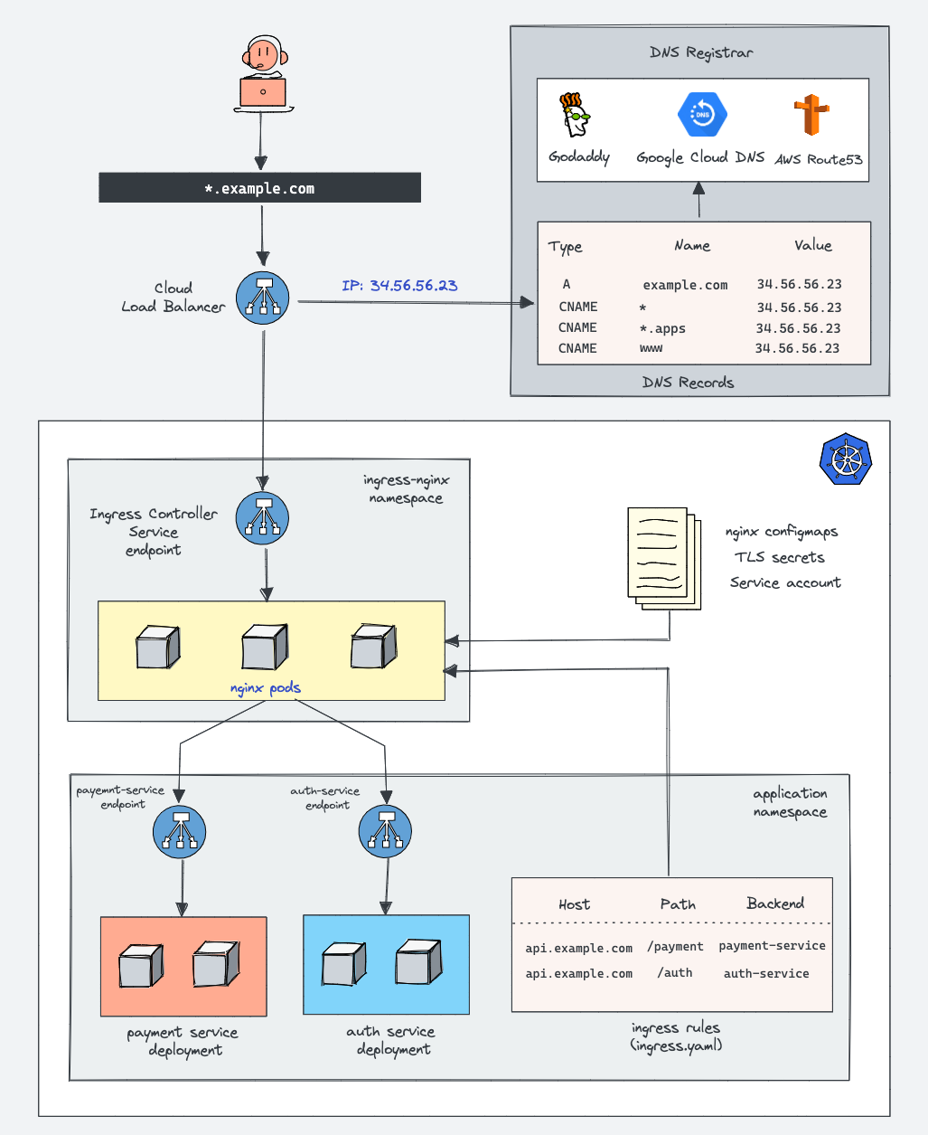

Slide 14
How does NGINX Controller work?
To have a working Nginx controller, we need to deploy the following Kubernetes objects :
ingress-nginx namespace
Service account/Roles/ClusterRoles for Nginx admission controller
Validating webhook Configuration
Jobs to create/update Webhook CA bundles
Service account/Roles/ClusterRoles of Nginx controller deployment
Nginx controller configmap
Services for nginx controller & admission controller
Ingress controller deployment

Slide 15
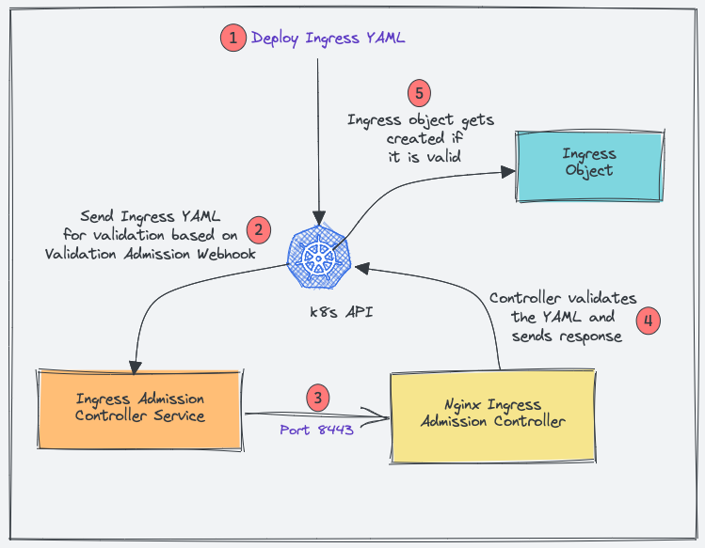
NGINX Admission Controller:
Admission Controller ensures that the ingress object you create has the correct configurations and doesn’t break routing rules
When you deploy an ingress YAML, the Validation admission intercepts the request.
Kubernetes API then sends the ingress object to the validation admission controller service endpoint based on admission webhook endpoints.
Service sends the request to the Nginx deployment on port 8443 for validating the ingress object.
The admission controller then sends a response to the k8s API.
If it is a valid response, the API will create the ingress object.

Slide 16
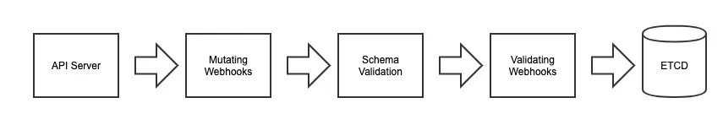
Validation Admission Webhooks:
Admission webhooks are HTTP callbacks that receive admission requests and do something with them. You can define two types of admission webhooks, validating admission webhook and mutating admission webhook.
A validating webhook is an endpoint Kubernetes can invoke prior to persisting resources in ETCD. This endpoint should return a structured response indicating whether the resource should be rejected or accepted and persisted to the datastore.

Slide 17
Advantages of Ingress Controllers:
Simplified Service Exposure: Ingress Controllers provide a straightforward way to expose services to the outside world.
Traffic Management and Load Balancing: Ingress Controllers allow for advanced traffic routing and load balancing strategies. This enables efficient distribution of incoming requests across multiple instances of a service, ensuring high availability and scalability.
Enhanced Security: Ingress Controllers often provide SSL termination, enabling secure communication between clients and services. They also support authentication mechanisms and request filtering, protecting the exposed services from unauthorized access and potential security threats.
Scalability and Flexibility: Ingress Controllers seamlessly scale alongside the Kubernetes cluster, adapting to changes in the number of services or replicas. They provide a flexible and extensible framework for managing ingress rules, allowing for easy customization and integration with other tools and services.

Slide 18
Thank You!

